Slide 1

Spotify Analysis
Group 5

Slide 2
Plan
Utilize Spotify APIs available to the public
Are the ‘Audio Features’ of tracks within a curated playlist similar?
Popularity Comparison between related artists & does their range in genre affect their popularity?
How popular is Doja Cat’s music?
How does a Doja Cat song change throughout the duration of the song?

Slide 3
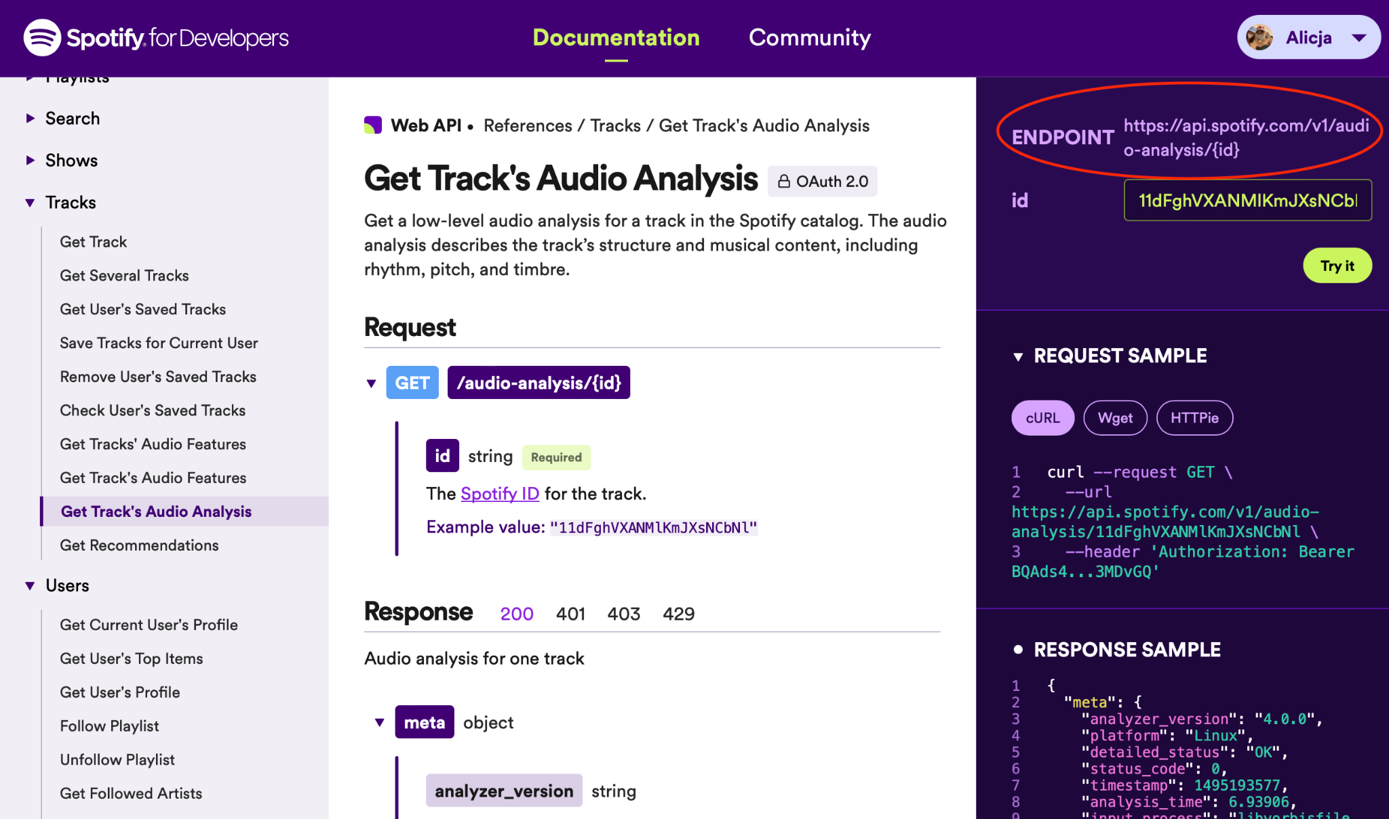
Getting the APIs

Slide 4
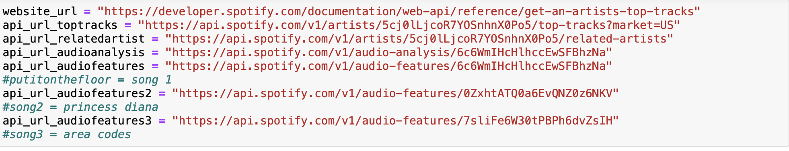
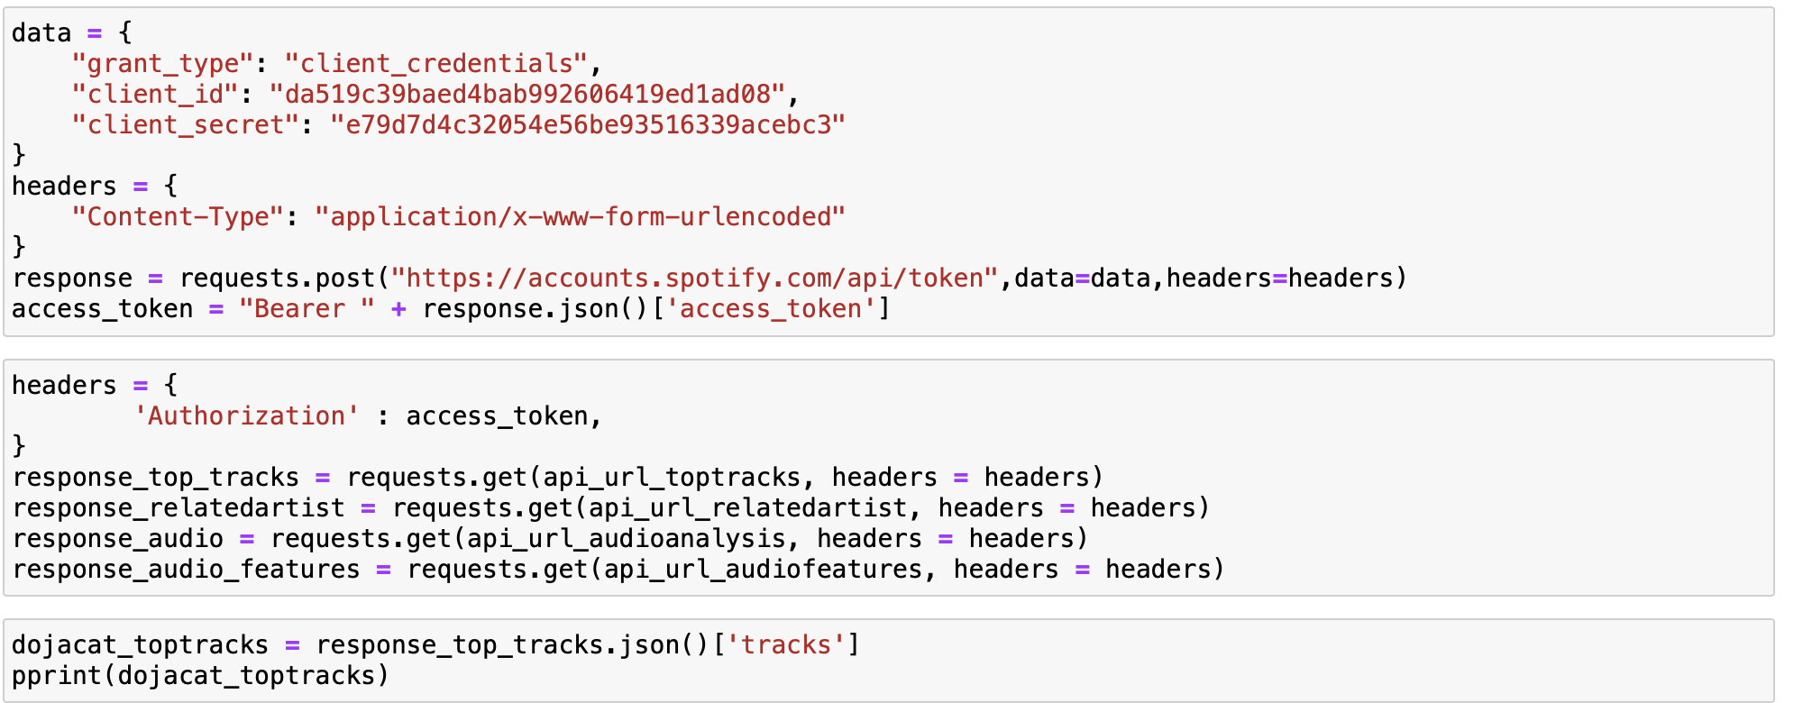
API Code

Slide 5
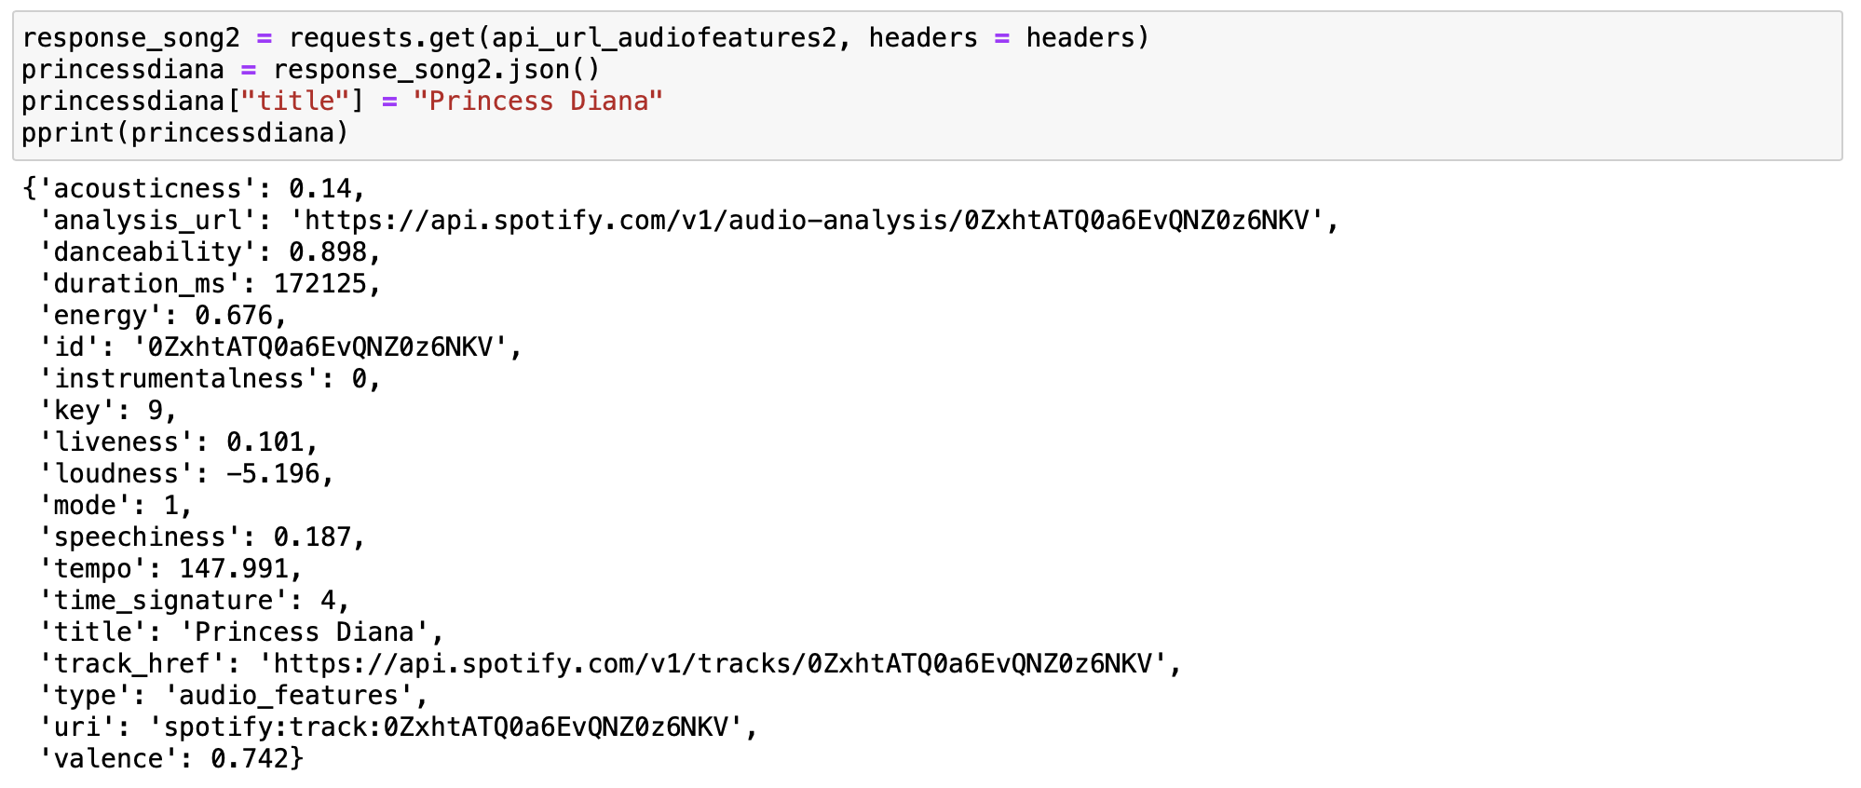
Data Sorting and Cleaning

Slide 6
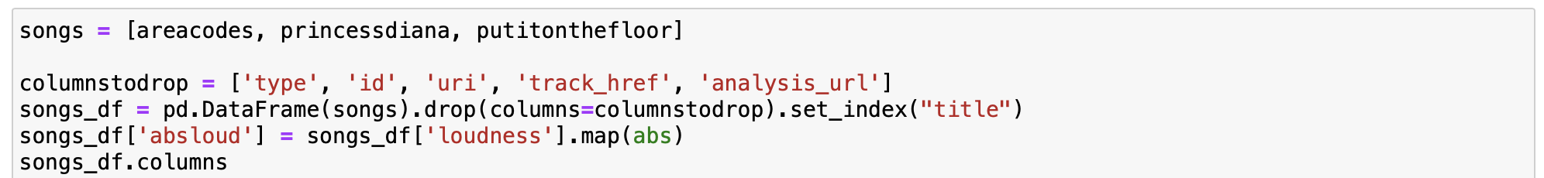
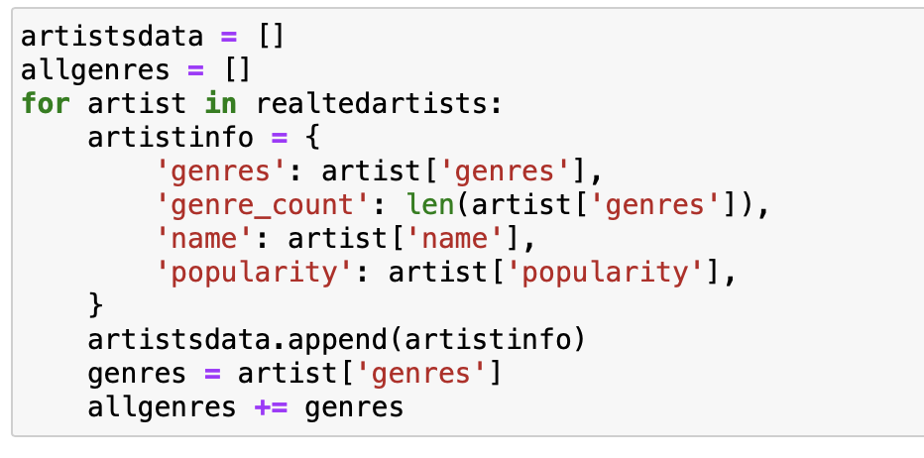
Data Sorting and Cleaning

Slide 7
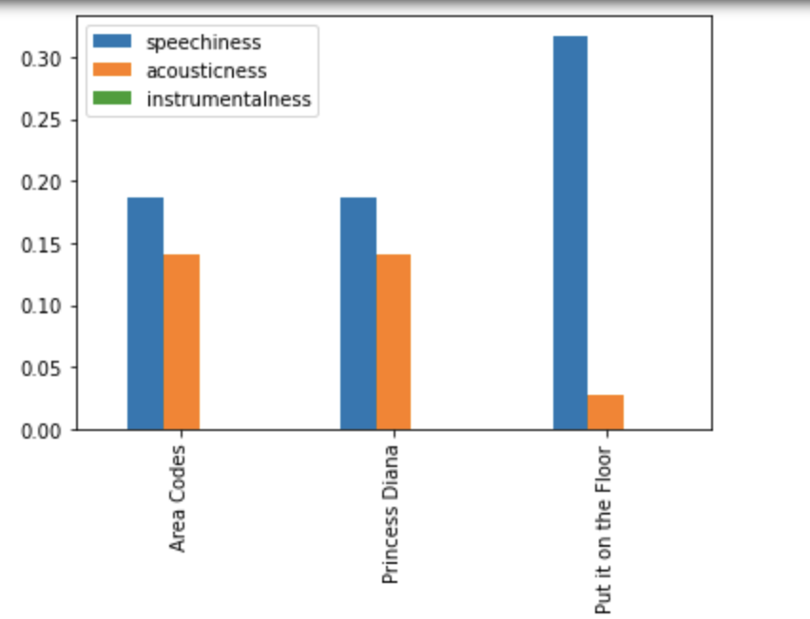
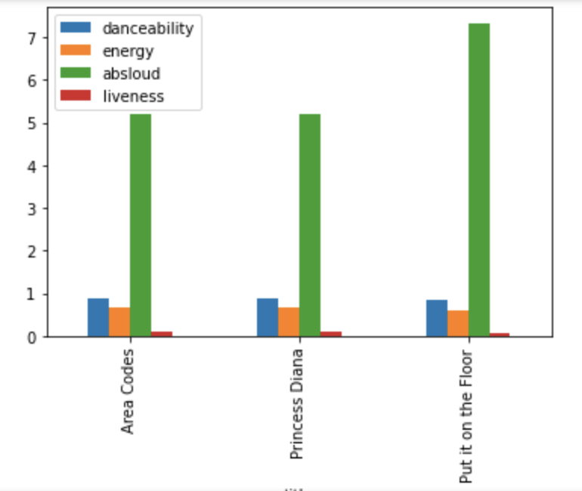
How similar are the ‘Audio Features’ of tracks within a curated playlist?

Slide 8
Analysis: Songs in a curated playlist
The songs all seem to have similar audio features and trends.
Put it on the Floor looks like it has the most Speechiness and Loudest volume
Future Interpretations of these results and considerations:
Spotify uses these results to group categories of music together for customer retention
Brining new music to customers which they may enjoy and add to their playlist
Limitation: User’s data to see how many people have like all three songs

Slide 9
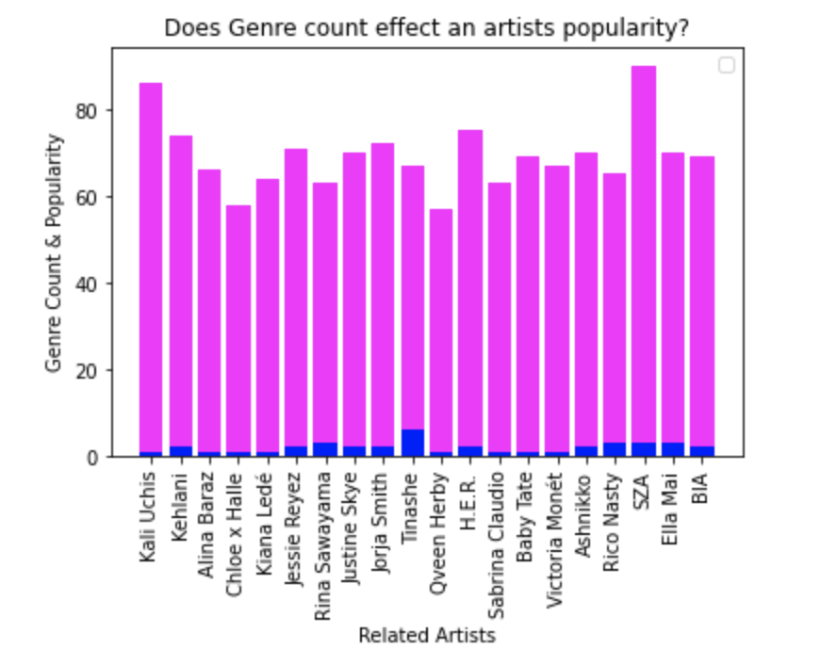
Popularity of Related Artists & does their range in genre affect their popularity?
There is no correlation between the amount of genres the artists fits into and their popularity

Slide 10
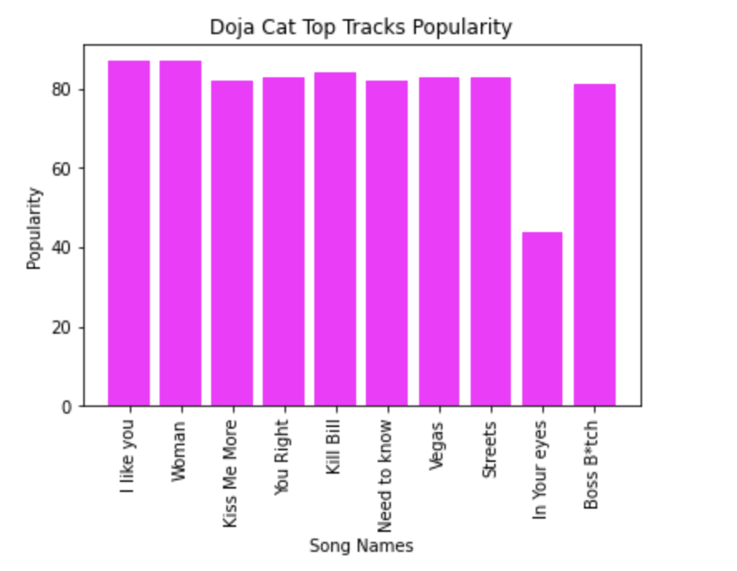
What are the popularities of Doja Cat’s Top Tracks?
Overall, her song popularity stays pretty consistent. “In your eyes” seems to be an outlier though.
A conclusion that may be inferred based off of this is that Doja Cat has a consistent fan base and users who frequent her.

Slide 11
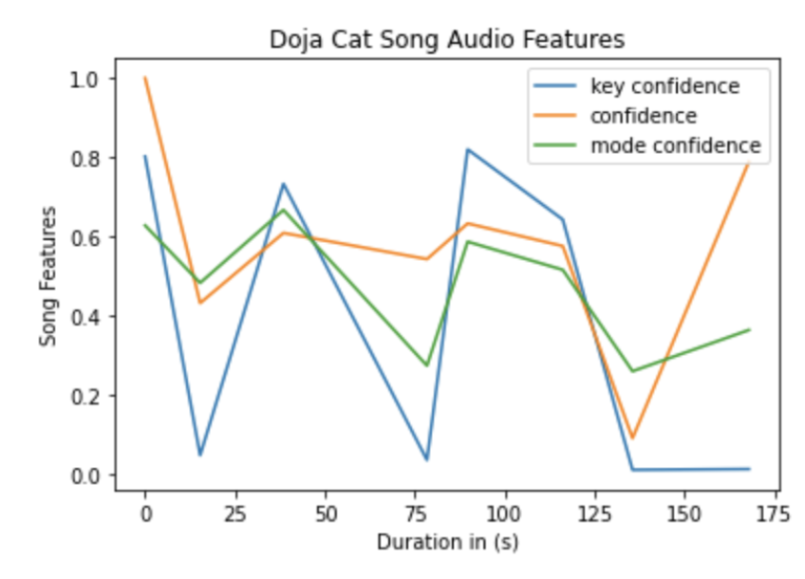
Doja Cat Song Confidence Change
Confidences change along the same path
At different standard deviations
Key Confidence changes the most throughout the song

Slide 12
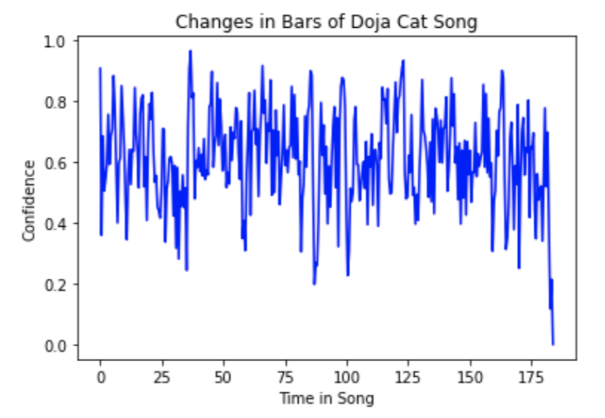
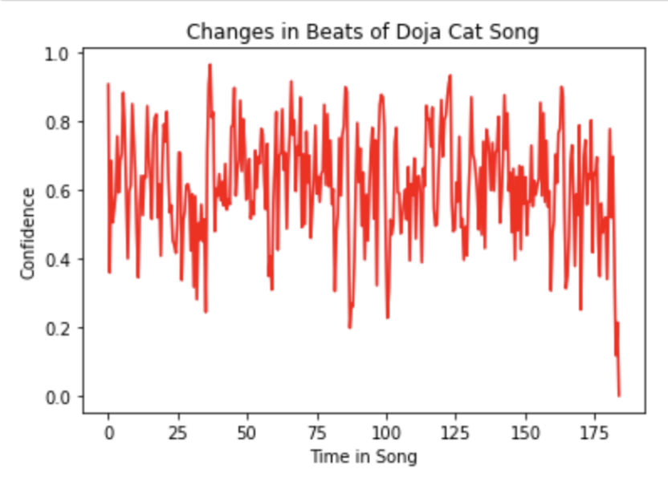
Doja Cat beats and bars
Doja Cat’s bar stay aligned with her beats
Applications:
An Artist can use this to see how in tune/ on rhythm they are with their music
An audio engineer can help to edit the beats based on this analysis to match the bars

Slide 13
Limitations
Missing user’s data to see how they interact with their artists
Missing playback times, repeats, skips, etc
Interactions with Songs
Missing Artist’s fan base data

Slide 14
Future Considerations/ Project Ideas
Looking at an artists fan base
Is it consistent?
Which songs are getting more likes/ listens? Do they have the same audio features?
Popular parts of a song by looking at when it gets skipped
Utilize Machine Learning to make curated playlists for users
Use audio features
Customer retention

Slide 15
Thanks for listening :)

